Slide 1
A Machine Learning Approach to TV Show Recommendation
Group Name: The Machineries
Fahim Md Rafiq 15101056
Tahsinur Rahman 15101128
Nawab Haider Ghani 15101064
Mir Ishrak Maheer Dhruba 15101007

Slide 2
Table of Contents
Topic Explanation ………………………………………………………………....... 03
Dataset ……………………………………………………………………………………. 04
Algorithm ………………………………………………………………………………… 05
Code Library ................................................................................. 06
Program Structure …………………………………………………………………… 07
Results …………………………………………………………………………………….. 08
Conclusion .................................................................................... 10
References ………………………………………………………………………………. 11

Slide 3
Topic Explanation
Area of our work :- Supervised Learning
Specifics :- Prediction Method
Area Covered:-
Data Mining
Data Analytics
User rating analysis

Slide 4
Dataset
We we will use data set format from TVDB website
Input Feature: TvShowId,UserId and ratings
Output Feature: Predicted rating for Tv shows and their names.
We will be using matrix factorization where rows will be users and and columns will be TV shows and each cell will contain rating of that tv show from a particular user.
If no rating(NaN) is present we will fill it with 0

Slide 5
Algorithm
Available Algorithms: SVM(Support Vector Machine), SVD(Singular-Value Decomposition), Naive Bayes, CNN(Convolutional Neural Network), Decision Trees, Collaborative filtering using matrix factorization with Stochastic Gradient Descent
Algorithm used: Collaborative Filtering using Matrix factorization with Stochastic Gradient Descent
Properties:
Predict the rating of a tv show by a particular user based on ratings of other users
Tv show content not very important
Prediction can be made even when there fewer ratings available
Stochastic Gradient Descent performs parameter update for each training example

Slide 6
Code/Library
Language and libraries to be used : python3, Sklearn, Pandas, Numpy, Matplotlib, Seaborn,
Code will be taken from a github account and some code will be written based on the tutorials provided by the youtuber sentdex/Siraj on the topic machine learning.
We went through various websites and found github and youtube to be of most help.

Slide 7
Program Structure
Python to create the overall system
Pandas and numpy will be used for data manipulation
Stochastic gradient descent will be used for predicting the rating of the tv shows
The dataset will be split in 75:25 ratio
For calculating accuracy we would be using accuracy_score method of scikit learn
We will compare the predicted ratings with the actual ratings.

Slide 8
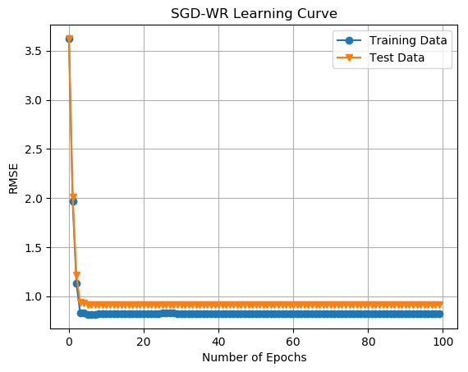
Results

Slide 9
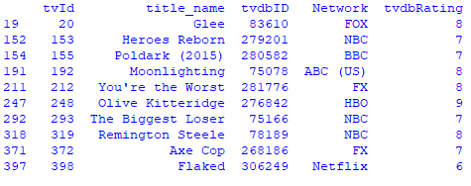
Results

Slide 10
Conclusion
Our aim is to have a executable file ready by the end of the semester which will successfully predict tv show ratings and in doing so will refer the user the highest rating predicted tv shows. While doing so we will acquire a basic understanding of how machine learning models work and how we can apply it on a given dataset.

Slide 11
References
[1] Koren, Yehuda, Robert Bell, and Chris Volinsky. "Matrix factorization techniques for recommender systems." Computer 42.8 (2009).
[2] Browne, Michael W. "Cross-validation methods." Journal of mathematical psychology 44.1 (2000): 108-132.
[3] Govan, Anjela. "Introduction to optimization." North Carolina State University, SAMSI NDHS, Undergraduate workshop. 2006.
[4] Ng, Andrew Y. "Feature selection, L 1 vs. L 2 regularization, and rotational invariance." Proceedings of the twenty-first international conference on Machine learning. ACM, 2004.
[5] Gemulla, Rainer, et al. "Large-scale matrix factorization with distributed stochastic gradient descent." Proceedings of the 17th ACM SIGKDD international conference on Knowledge discovery and data mining. ACM, 2011.
[6] Bottou, Léon. "Large-scale machine learning with stochastic gradient descent." Proceedings of COMPSTAT'2010. Physica-Verlag HD, 2010. 177-186.

Slide 12
References
https://www.thetvdb.com/
https://github.com/ah3200/movielens
https://www.youtube.com/user/sentdex
https://www.youtube.com/watch?v=W9iWNJNFzQI
https://www.youtube.com/watch?v=nhqo0u1a6fw
https://grouplens.org/datasets/movielens/

